Slide 1

INTRODUCTION TO MACHINE LEARNING

Slide 2


Introduction to machine learning
What is machine learning?
Is the process of teaching a computer how to find patterns in data to make predictions based on new unseen data.
00

Slide 3
Introduction to machine learning
There are three main types of learning:
Supervised: we show to the computers sets of pairs: (example, solution)
Unsupervised: we show the computer how to group and let it work, clustering
Reinforcement learning: learning by doing ( actions, rewards )
How we can teach the computer?
00

Slide 4
Introduction to machine learning
Do you remember the two types of variables / features? ( Numerical and Categorical? )
Now is when this distinction makes sense as we can have two types of problems in supervised learning:
Regression: (prediction of a numerical feature)
Classification (prediction of a categorical feature)
Supervised learning

Slide 5
Introduction to machine learning
The case where we do not have data on an outcome.
Clustering is the most common UL problem: grouping data points with the ones where they share most characteristics.
We can’t evaluate the performance (depending on the question there may be other ways to evaluate)
Un supervised learning

Slide 6
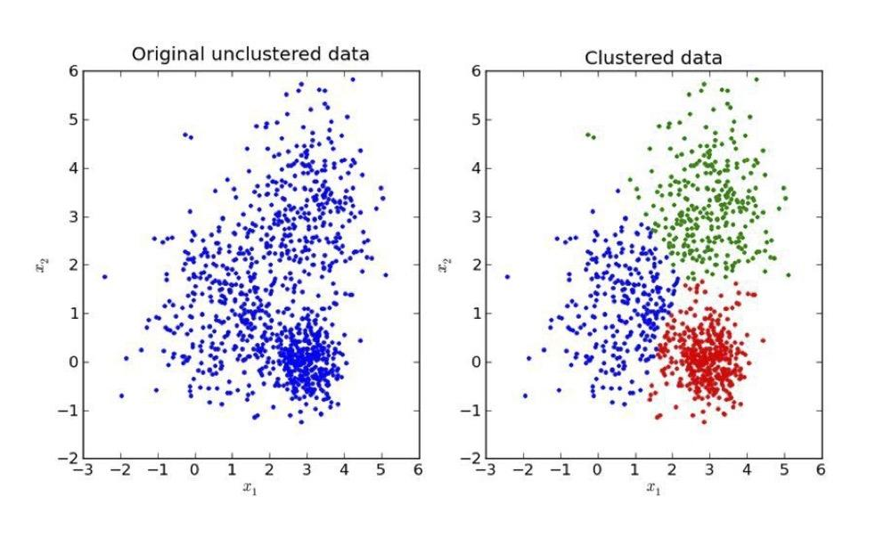
Introduction to machine learning
Clustering is the process of grouping data without telling the computer to which group belongs every observation.
Clustering

Slide 7
Introduction to machine learning
For K number of groups, pick K random locations (centroids)
Calculate the distance of each observation to every centroid.
Assign every observation to the nearest centroid.
Adjust centroids locations to the mean location of every member of the cluster
Repeat until centroid locations doesn’t change significantly (to be defined)
K-Means

Slide 8
Introduction to machine learning
What if the initial centroids locations are chosen poorly? (We need to try with several starting positions)
What if the number of groups is chosen poorly?
How do we measure ‘distance’?
K-Means

